Slide 1

Monitoring and Alerting
DevOps {dev}School 2022
Andrada Răducanu
May 2022

Slide 2
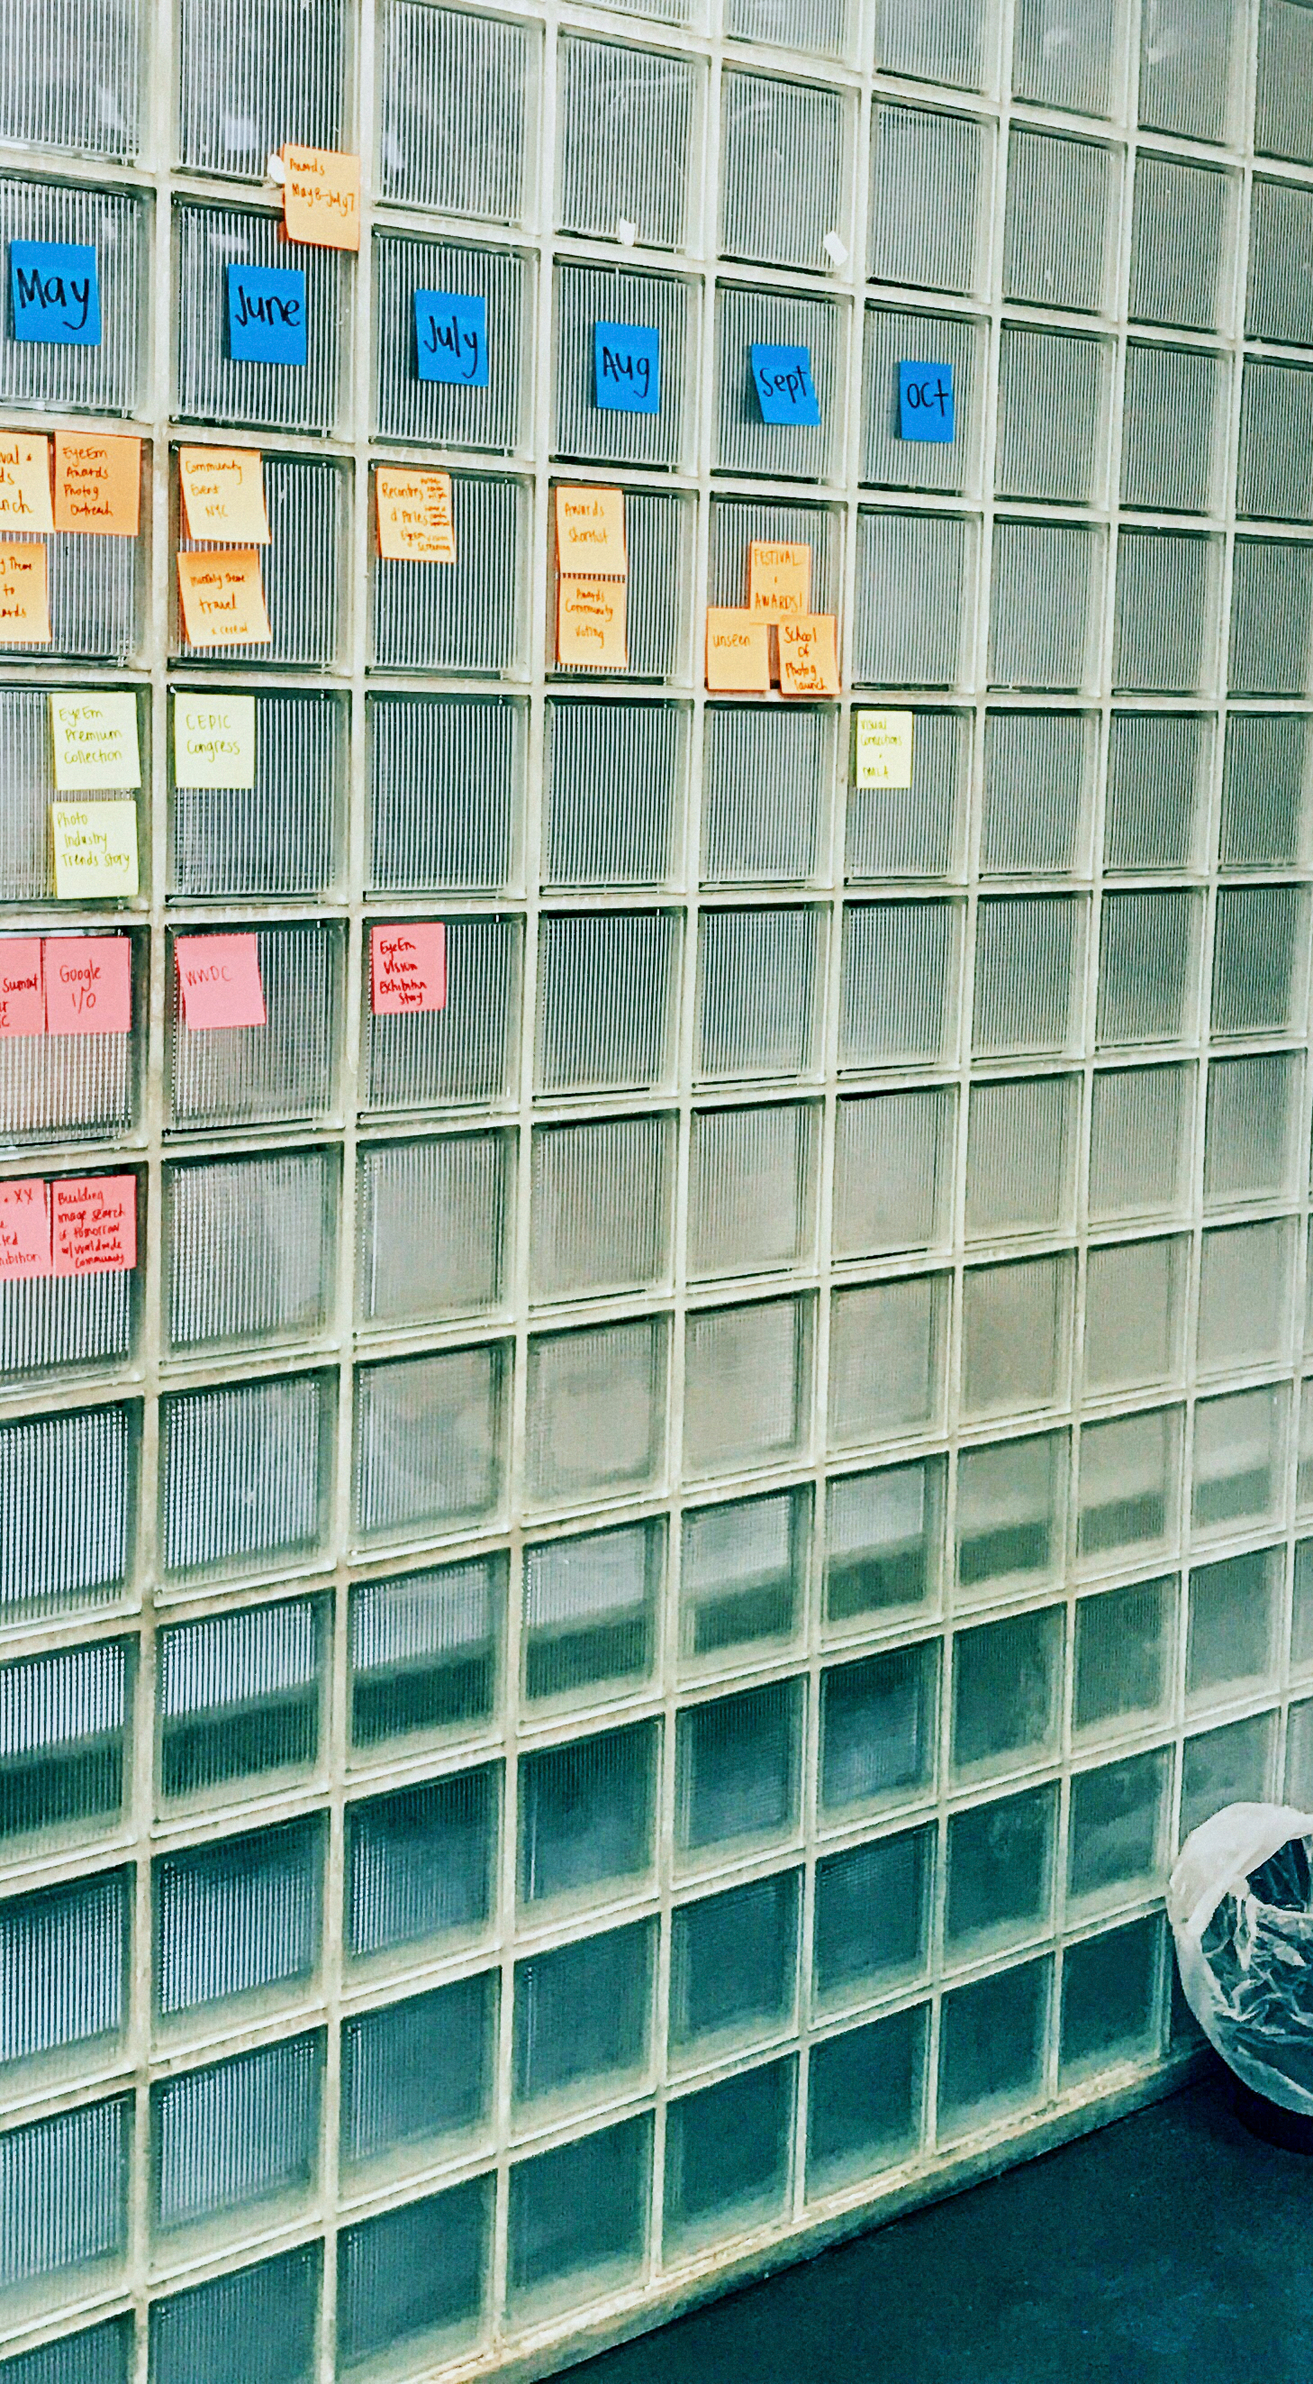
Agenda
Why do we do monitoring and alerting?
Types of monitoring
Technologies used in ING
Prometheus
Grafana
ELK stack

Slide 3
Why do we do monitoring?
And what is it, first of all?
health
Lifecycle Management (LCM)
Performance
Statistics
Being proactive
Optimization
History
Notes:
To speak by the book: Monitoring provides feedback from production and delivers information about an application’s and a system’s performance and usage patterns; when performance or other issues arise, relevant data about the issues are sent back to development teams through automated monitoring.
In other words: we are monitoring our infrastructure and our applications to make sure that they stay alive and they function properly. Infrastructure monitoring means hardware and OS and application monitoring means performance, availability, response time and many others.
Why do we monitor?
Make sure that our system stays healthy: hardware and OS errors, application becomes unavailable or behaves in an unexpected way.
Lifecycle management (eg.: vulnerability patch/mitigation of the OS/library used in the application).
Performance: keep the latency of the system and of the application in control; product scales out and you need more resources.
Statistics: stakeholders love them.
Being proactive: be like a doctor and prevent an issue before it turns into a illness and in our case, a major incident.
Optimization: the metrics we look at can tell us a lot about how efficient the system behaves and we can act accordingly.
History: useful for traceability of the system and how it behaved in the past.

Slide 4
Why do we do alerting?
And what is it, second of all?
Being proactive
Traceability
Notes:
Alerting lets us carry on with our lives as DevOps engineers without having to look 24/7 at our pretty monitoring dashboards. Those are systems that based on monitored data from our systems, notify us that something is not working as it should be.
Why do we do alerting?
Being proactive: sounds familiar? A very good example for this is storage. Monitor your storage usage, but never look at the actual metrics and your system will crash for sure, breaking your availability agreements with your stakeholders.
Traceability: ticketing systems. Any alert and activity performed based on an alert must be documented with a ticketing system so you can have proper traceability in place.

Slide 5
Types of monitoring
Or how we also like to call it, types of continuous monitoring:
Infrastructure monitoring
Application monitoring
Network monitoring
Notes:
Continuous monitoring: the process of monitoring each and every phase of DevOps and IT operations lifecycle. This process ensures the health, performance, and reliability of the application.
Infrastructure monitoring: pretty straight forward. We are talking about hardware and OS here because if something here is faulty it directly impacts how the application behaves. The components that interst us are CPU, RAM, Disk utilization etc. In ING, for this one we use Prometheus.
Application monitoring: here we are interested in metrics like availability, health, performance, user response time etc. In ING, for this we use Prometheus as well, and ELK.
Network monitoring: we are interested in the physical components here like switches, routers, firewalls and so on and we’re looking at bandwidth, uptime, bottlenecks etc.

Slide 6





Technologies we use at ING
Notes:
From right to left:
Prometheus+Grafana: two open-source tools used for monitoring the applications. Prometheus stored the metrics at backend and Grafana visualize those metrics.
Elasticsearch+Logstash+Kibana aka ELK Stack: a collection of 3 open source products manged and developed by Elastic. Elasticsearch is an open source, full-text search and analysis engine, based on the Apache Lucene search engine. Logstash is a log aggregator that collects data from various input sources, executes different transformations and enhancements and then ships the data to various supported output destinations. Kibana is a visualization layer that works on top of Elasticsearch, providing users with the ability to analyse and visualize the data.

Slide 7

Prometheus
Time series database TSDB
Data Retrieval Worker
HTTP Web Server
How much Greek mythology do you know?
Notes:
How much Greek mythology do you know? Just joking, a fun fact about Prometheus: in Greek mythology, he was an immortal Titan who defied the will of the Gods by stealing fire and giving it to humanity; thus creating civilization. How is this relevant to us? Much like the Greek Titan, this monitoring tool brings light over how our system and application is performing. Another fun fact: it was created by SoundCloud.
Prometheus collects metrics (information/data about how a component behaves) and analyses them. Key components:
It has a time series database (the data is stored with the timestamp when the event that generated the data was registered) that stores the metrics data;
It has a data retrieval worker that gets or pulls the metrics from the application/services etc. and stores/pushes them into the database
It has a web server that accepts queries for that stored data; the language it accepts the queries is called PromQL. The web server is used to display the data using the web UI or other data visualization tool, like Grafana

Slide 8
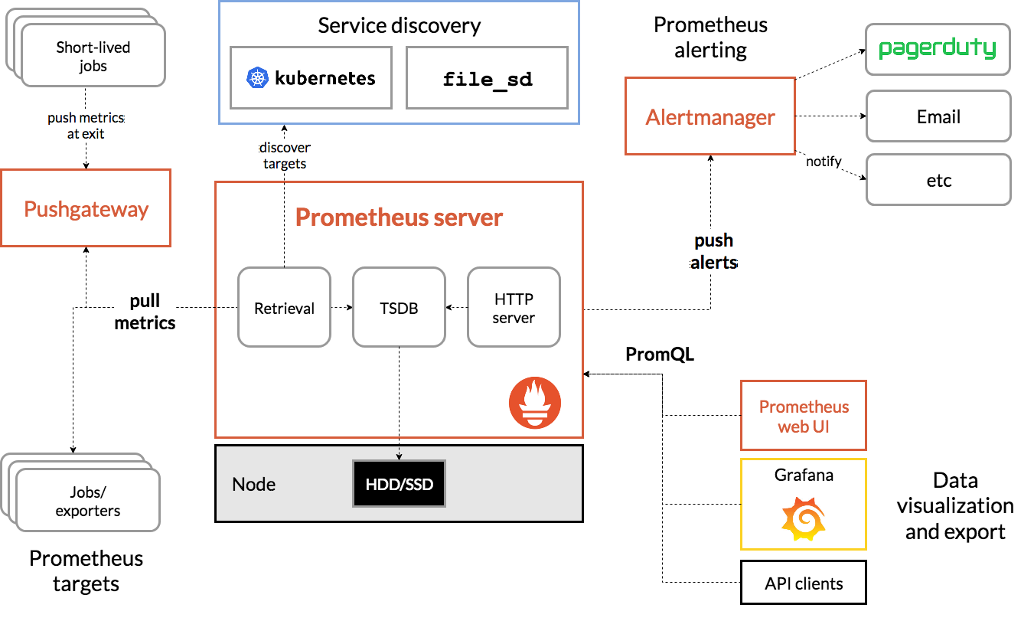
Prometheus
Architecture
Notes:
The things that Prometheus monitors are called targets.
Each target has units of monitoring. (Eg.: for a Linux Server target, the unit is CPU usage). The unit you would like to monitor for a specific target is called a metric. Metrics are what gets saved in the TSDB.
The metrics are human-readable text-based.
The image might look scary, but we will take it step by step:
The Pushgateway component: gets metrics are pushed by targets
In the Prometheus server:
The data retrieval worker: pulls metrics from the Pushgateway, other targets (jobs/exporters), discovered targets (k8s)
The TSDB: gets data pushed from data retrieval worker and HTTP server into the database which gets stored on the physical node’s hdd/ssd
The web server: receives queries from data visualization components and pushes alerts to the Alertmanager
The Alertmanager: notifies the engineers via various ways.

Slide 9
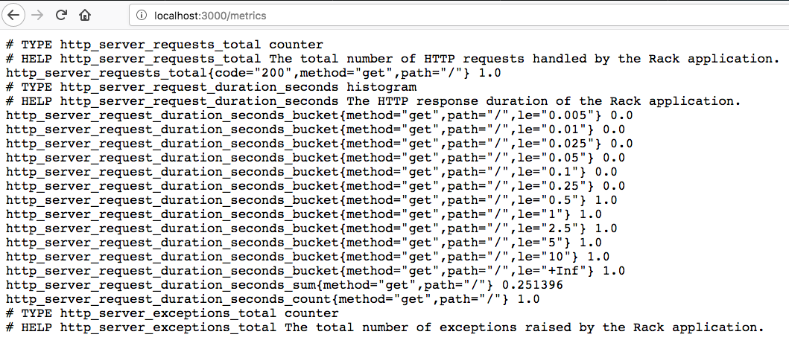
Prometheus
Human-readable text metrics
Notes:
And this is how the metrics look after they are scraped by Prometheus from your targets.
What’s scraping? Scrape is the action that the Prometheus server performs, when it fetches metrics data from a list of configured targets.

Slide 10
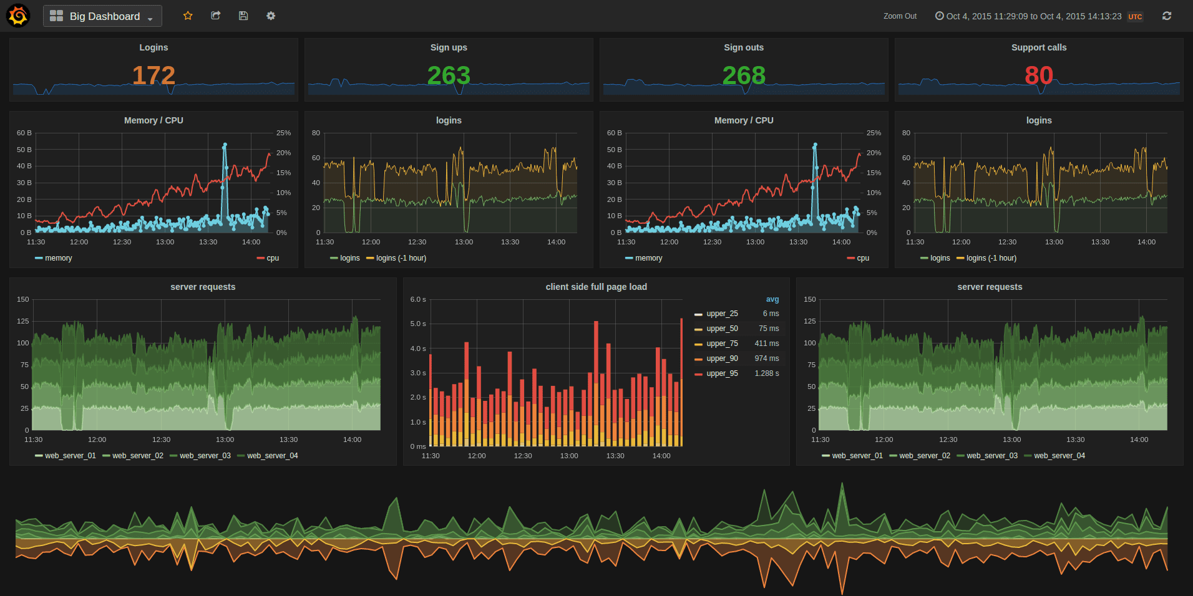
Grafana
😱
Data Vizualization Tool
Notes:
Going by the book (again): Grafana is open-source software that allows you to combine many different data sources converting your data into graphical visualizations for observability.
In plain English: Grafana provides what you need to make your data from a TSDB into nice graphs and visuals so it’s easier to read and just look at it.
What’s that horror in this image? It’s a dashboard (multiple panels in a single grid) made in Grafana. And because a dashboard on its own has no use, we need some data points to properly view our information. The visualizations cand be done in many ways: tables, line graphs, charts, heat maps, scatter plots etc. The data points come from many sources and are stored in different formats, but the one that interests us the most today is the time series database ones.
Being such a popular tool, the community contributions are very important to support those many types of visualizations and connectors for the different data sources.

Slide 11
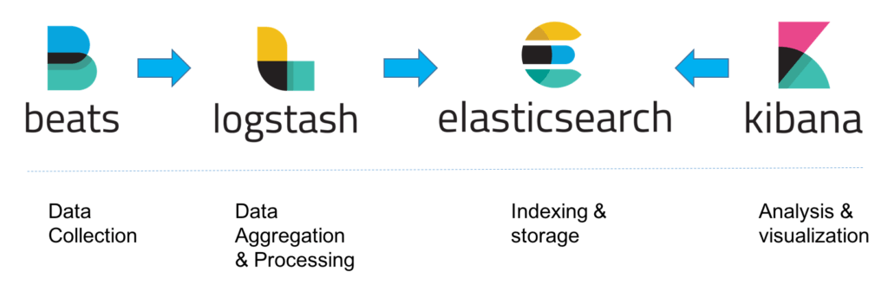
Elastic stack
Almost 3 in 1, like Nescaffe
Notes:
I already gave you a big definition some slides before. Forgot to mention that the stack is open source ☺
The various components in the Stack were designed to interact and play nicely with each other without too much extra configuration. In a small-sized development environment, you can use the configuration from the picture above.
Let’s take a closer look at each component.

Slide 12
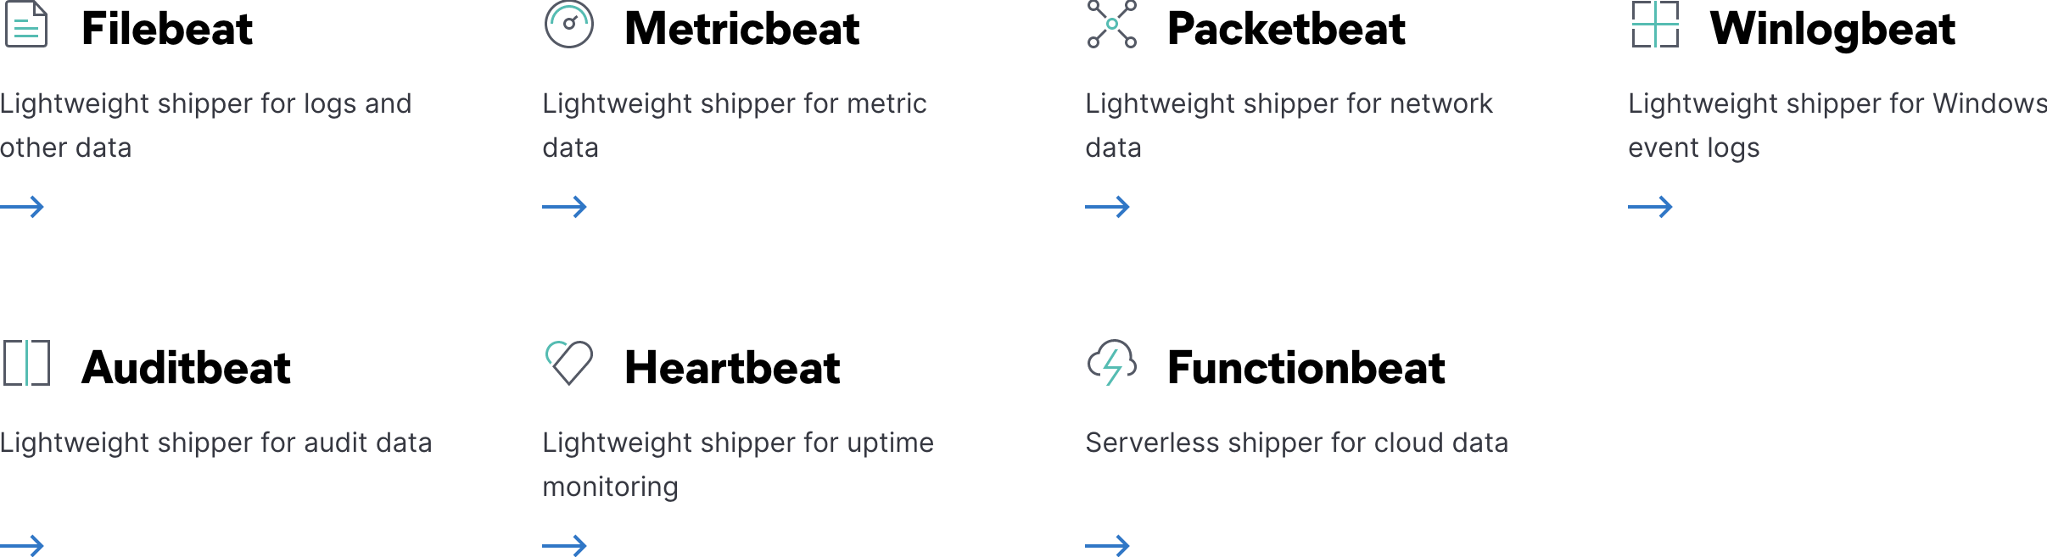
Beats
Collect Data
Notes:
Beats represents the logshippers we use to collect the data from whatever we want to collect logs from. The are multiple flavours of loggers, depending on the type of equipment we want logs from and the type of logs.
The *beats shippers are agents installed on your equipments and are written in Go. They are lightweight, resource efficient and don’t have dependencies.
Once collected, the logs are shipped into the next component in the stack (either Logstash or Elasticsearch).

Slide 13

Logstash
Shipp and proccess logs
Notes:
Logstash is the log analisys tool we use to easily search, analyze and visualize the data; it’s the workhorce of the stack, in charge of proccessing and enhancing the log messages, messaging and dispatching them into a defined storage destination.
The events go through 3 stages:
Collection: here we use input plugins to aggregate the data and events from various sources;
Proccess: here we use filter plugins to enrich and manipulate the logs; the filters can also have conditional statements; what filter we use in ING? Grok.
Dispatch: here we use output plugins where we define the destination where we want the logs to go. (e.g.: take a CSV output and convert it to be sent to PagerDuty).

Slide 14

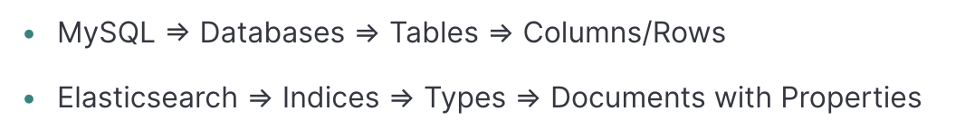
Elasticsearch
Store logs
Notes:
This component is so vital to the stack, that it has become a synonym with the stack itself.
The engine is rich in features and stores data in an unstructured way, being categorized as a NoSQL database. The easiest way to get data from Elasticsearch is to make use of its extensive REST API.
Basic concepts:
Indices: logical partitions of documents (like an actual relational database)
Documents: JSON objects stored in an index, they are the base unit of storage (a row in a relational database)
Types: used in documents to subdivide similar types of data
Mapping: defines the different types that reside within an index (a schema in a relationa database)
Shards: an index split horizontally into pieces in order to distribute the operations to improve performance
Replicas: copies of shards used to recover from system failures.
Bonus: Each index is configured for a certain number of primary and replica shards.

Slide 15
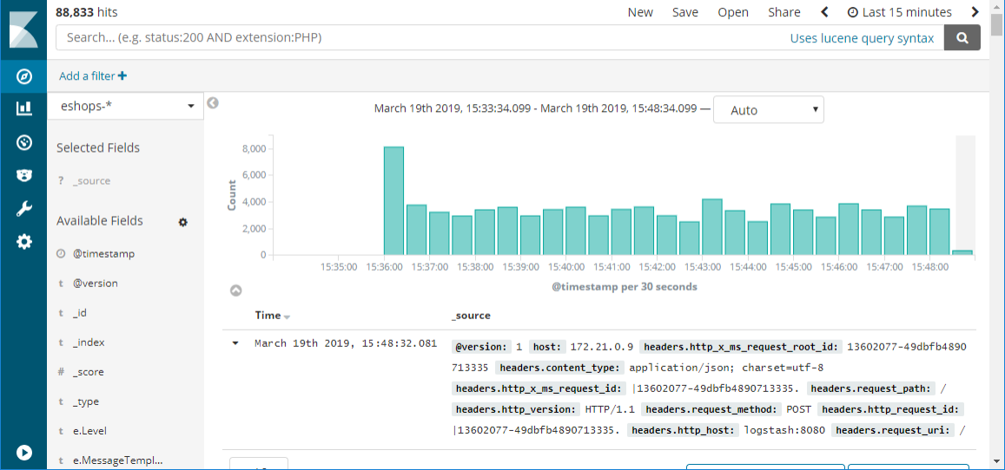
Kibana
Visualize the logs
Notes:
The window into the stack.
Much like Grafana, Kibana is used to search, analyze and visualize the data stored in Elasticsearch indices.
Similar with Prometheus this time, Kibana uses its own language called KQL (Kibana Querying Language) to search into the data (this is similar with Lucene and it also works in Kibana).

Slide 16
How we do it in ING
Notes:
Prometheus & Grafana: You can use the Prometheus UI, but you don’t really want to do that, trust me. Those 2 are pieced together and are how most of our teams use them. Each team deployes its instance of Prometheus & Grafana, they create their own dashboards (in JSON format). A while ago, we were a big monolith with a main Grafana server, but now we have splitted in separate deployments.
ELK stack: we use a customized RPM package of Filebeat to configure the beats part. We also use the other components described. The Kibana dashboards were separated per team per environment in the past, but now we have what we call topics for those environments with multiple wildcards for the teams to find their logs.

Slide 17

I bored you enough.
It’s demo time.

